Slide 1
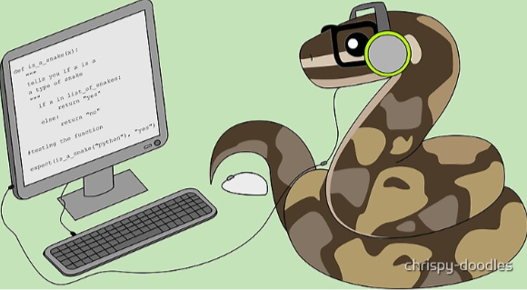
Introduction to Python and AI Assisted Coding

Slide 2
Goals for this Week
Monday February 9th
Introduction to Using Python
•Formats of Python
•Grammar/Syntax
•Basics
•Object Types
•Simple Functions
•Variables
•Intro to Indexing
•Input
Wednesday February 11th
Foundational Tools
•Lists
•Dictionaries
•File Handling
•Indexing lists and dictionaries
•Loops and Conditions

Slide 3
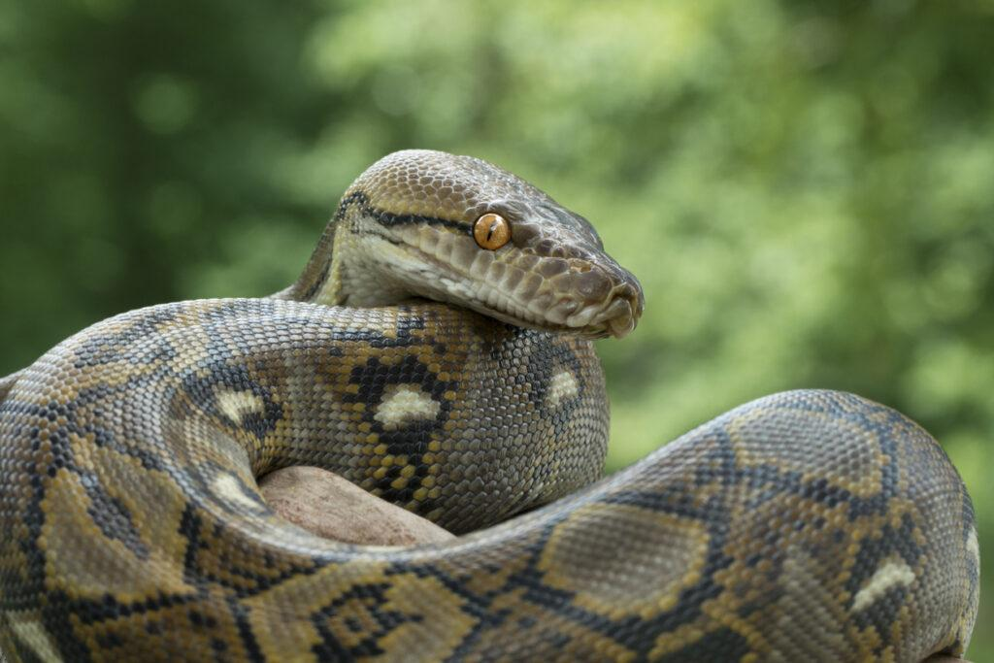
What is Python?
Pythonidae family
~10 species
Native to tropics of Eastern Hemisphere (Africa and Asia)
Constricting snake

Slide 4
What is Python - How it Works
For every person in the room
zig-zagging starting from the person in the left corner closest to me
Say Your Name and your department
If your name starts with a vowel - clap your hands
If your name starts with a consonant - snap your fingers
If you are not in the wrong class, please let me know

Slide 5
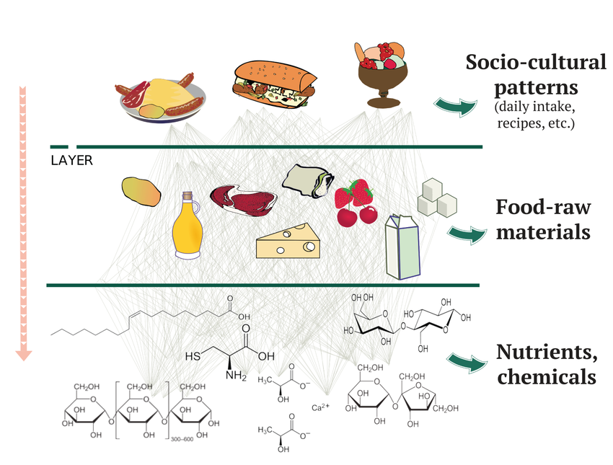
What is Python-Layers of Abstraction
More Generalized
More Abstract
More Specific
Less Abstract

Slide 6

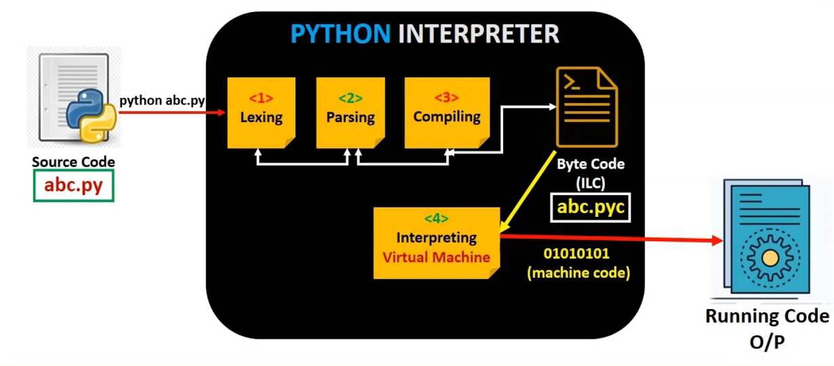
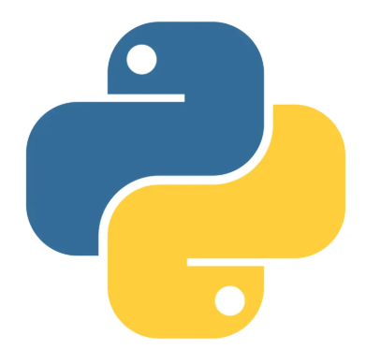
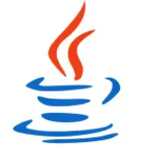

What is Python – Interpreted Languages
Abstraction
User Friendliness
Visual
Drag-and-Drop Programming
Interpreted Language
Compiled Language (C, C++)
t2 = t6 + t2
Assembly Code (Intel X86)
add $t2 $t6 $t2
Machine Code (Hexadecimal)
0x014E5156
Complexity
Speed
Binary Code
00000001010011100101000101010110

Slide 7
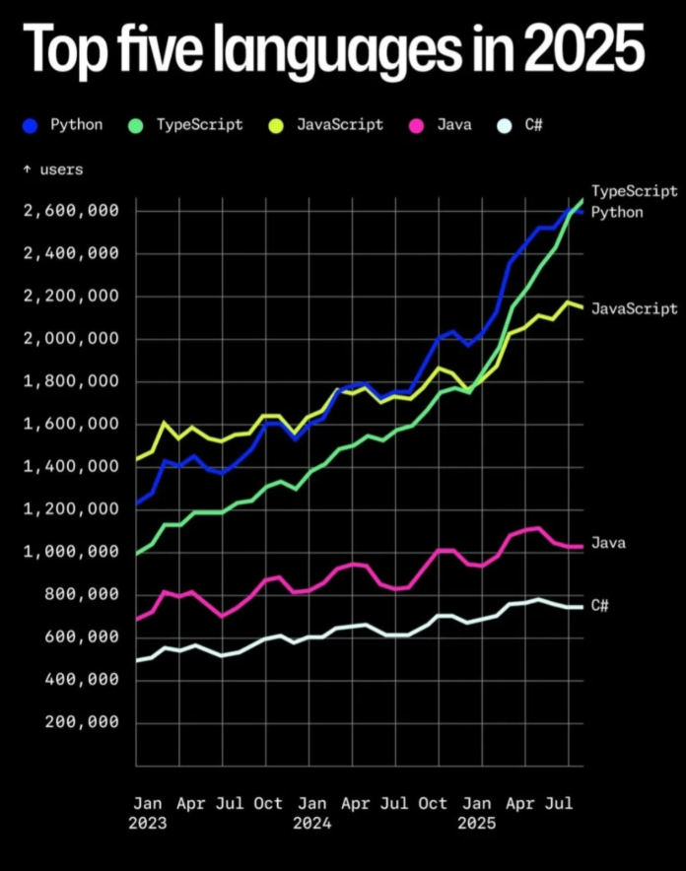
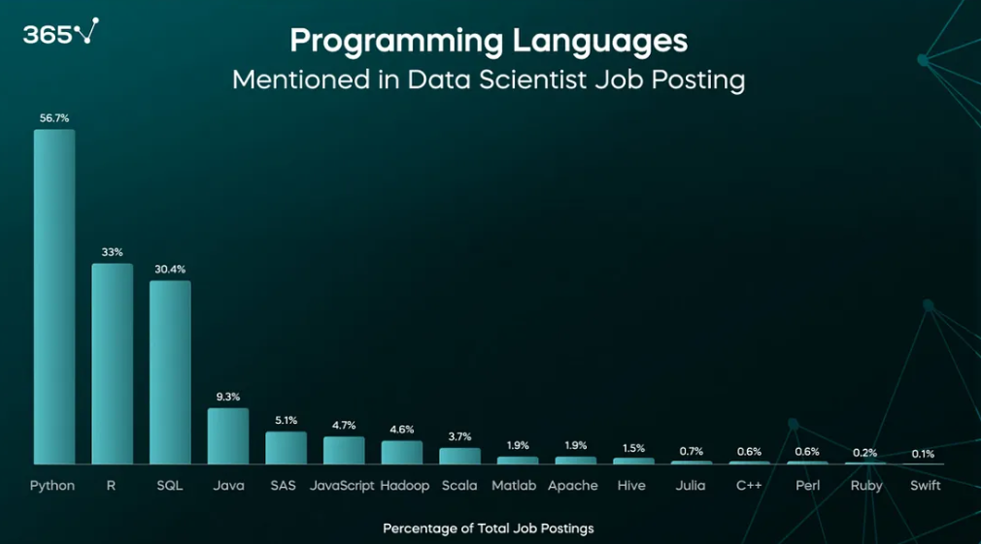
Python continues to be the most widely used general interpreted language

Slide 8
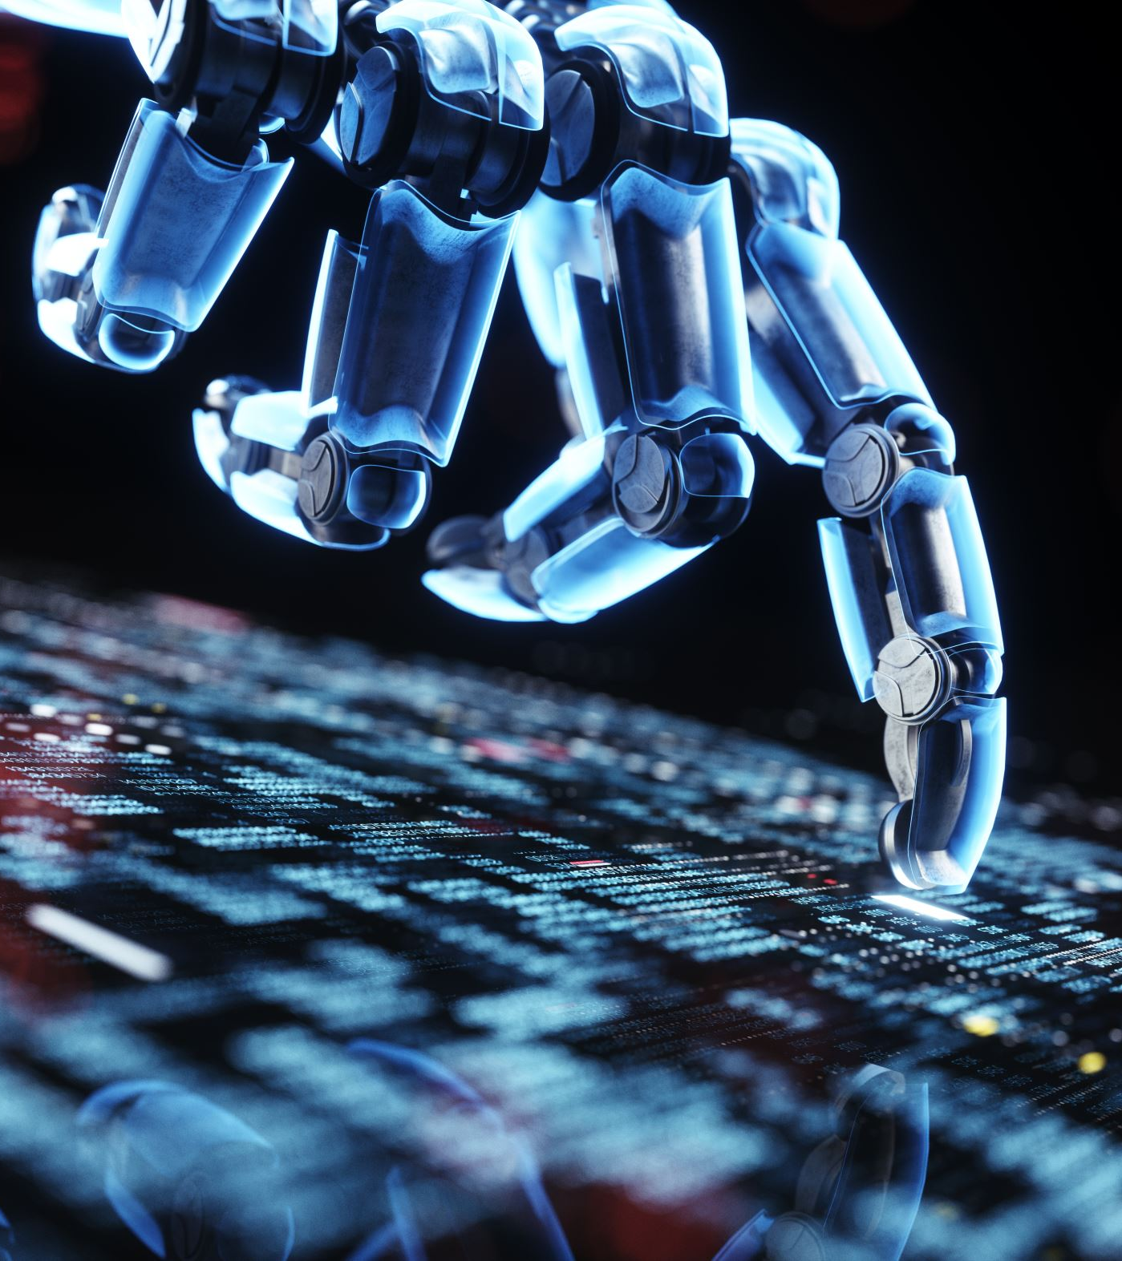
What can you use it for?
Data Analysis and Visualization
Backend web development
Apps / Games
Productivity / Automation / Pipelines
Web Scraping
Machine Learning

Slide 9
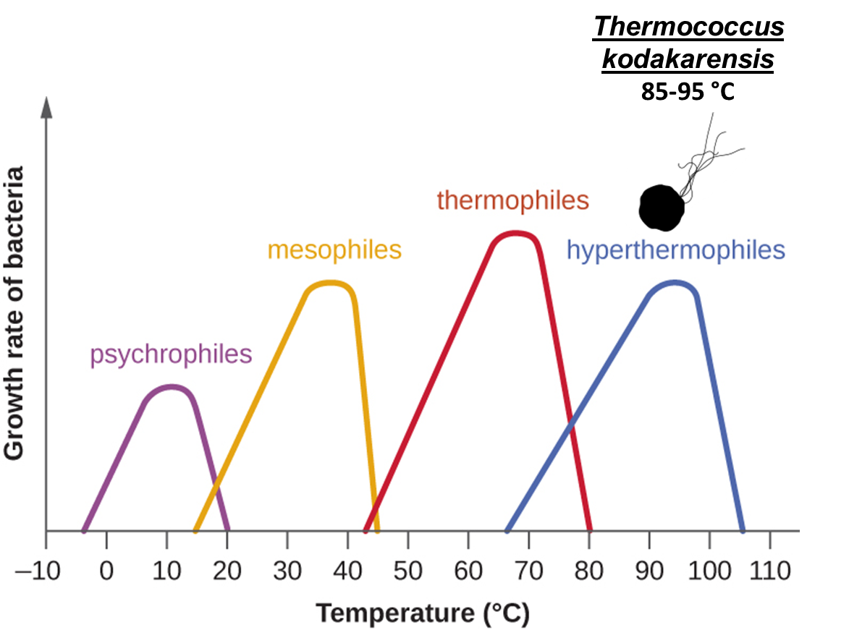
My Application of Python

Slide 10
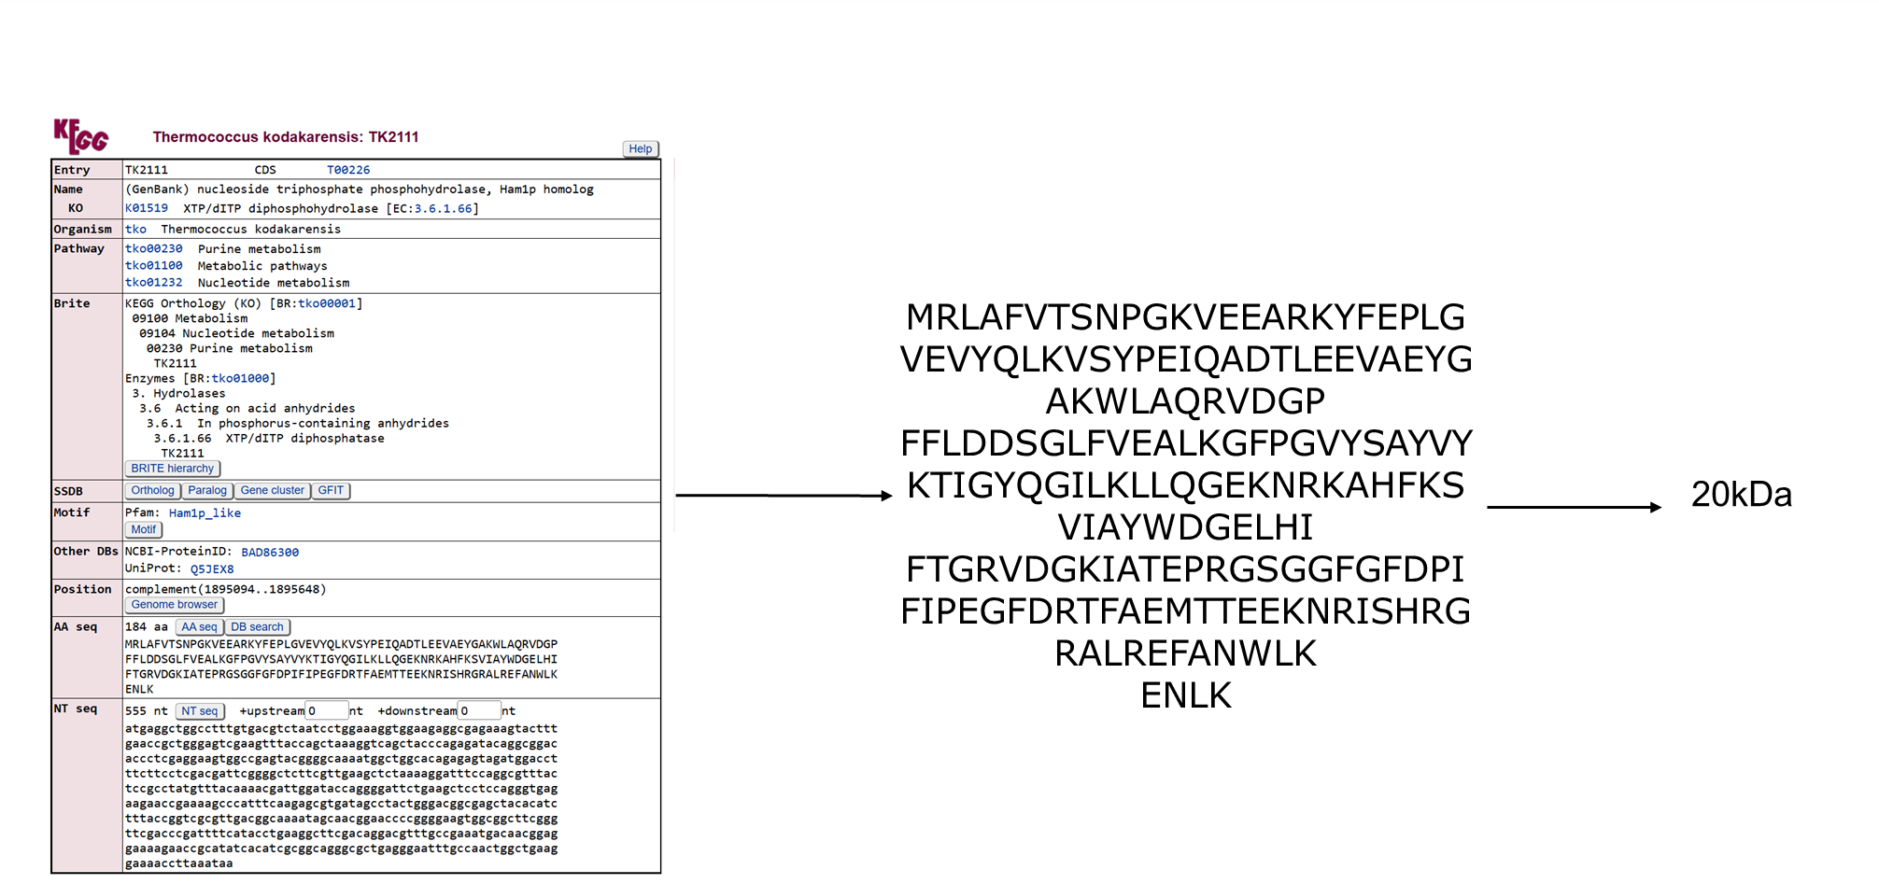
Old School Way of Looking for a Protein Based on Size

Slide 11
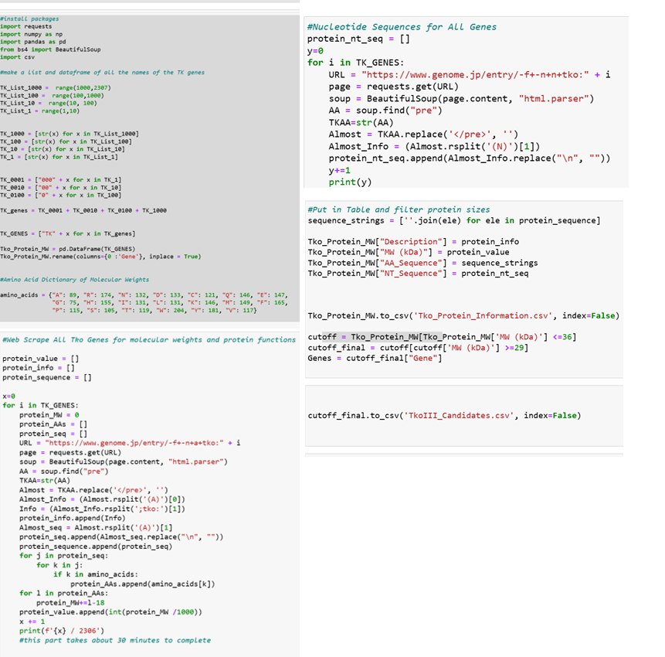
New School Way of Looking for a Protein Based on Size

Slide 12
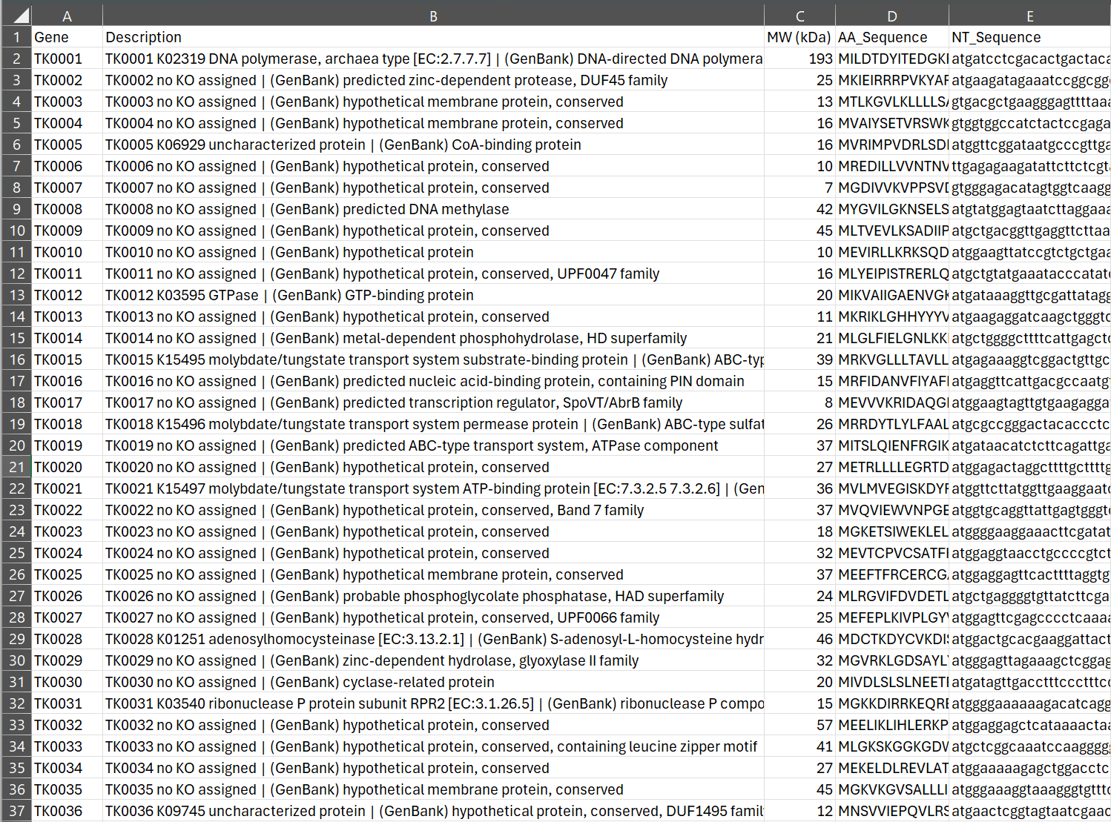
New School Way of Looking for a Protein Based on Size

Slide 13
But…ChatGPT could have just written your code for you.
Prompt: Write me python code that takes every thermococcus kodakarensis gene in the Kyoto Encyclopedia of Genes and Genomes and provides an output csv file with the gene number, the annotation, the protein sequence, the molecular weight in kDa, and the nucleotide sequence. I have no coding experience so I want just a script, no defined functions. Also I want you to only use requests, numpy, csv, ,pandas and BeautifulSoup as your modules.

Slide 14
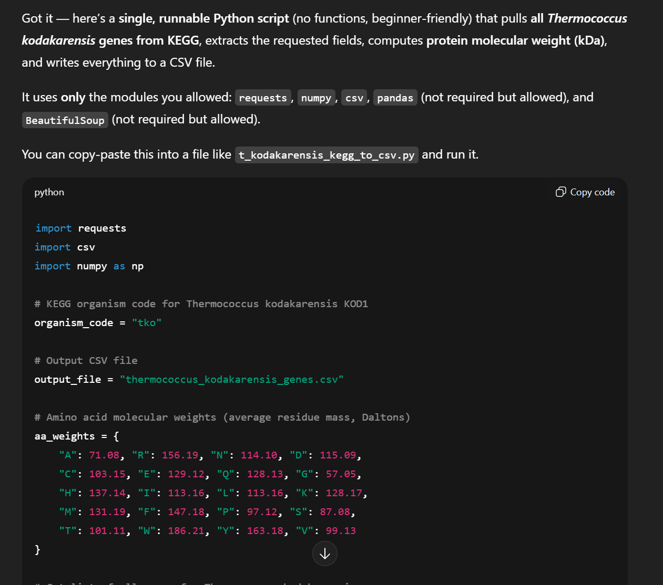
Seems legit, right???

Slide 15
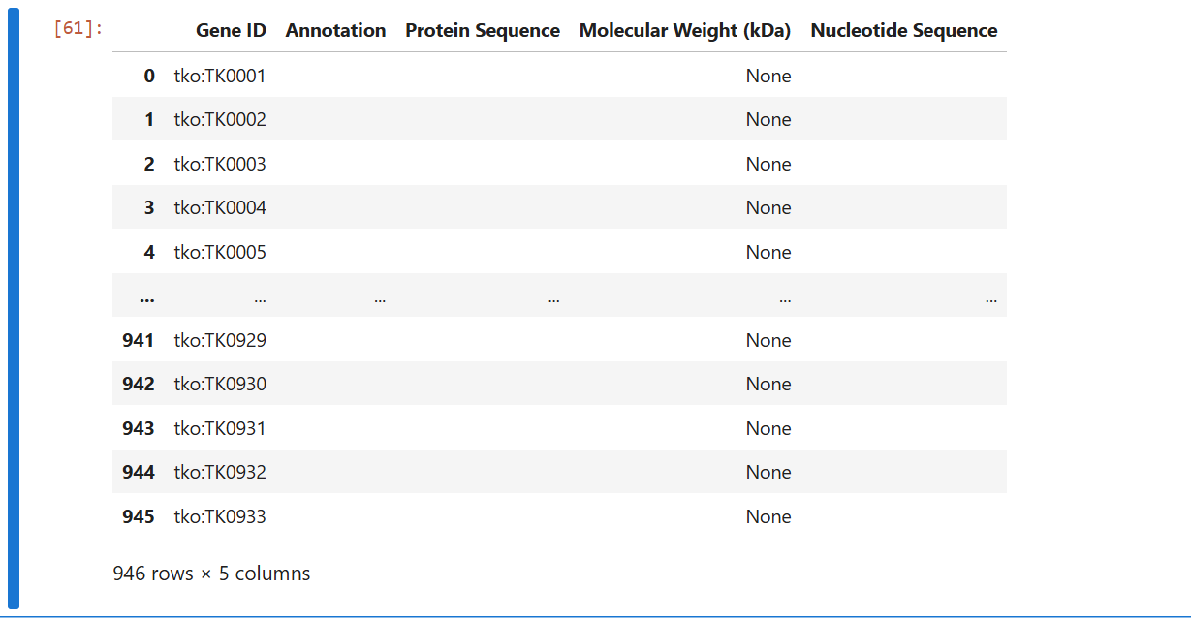
No…not legit…

Slide 16
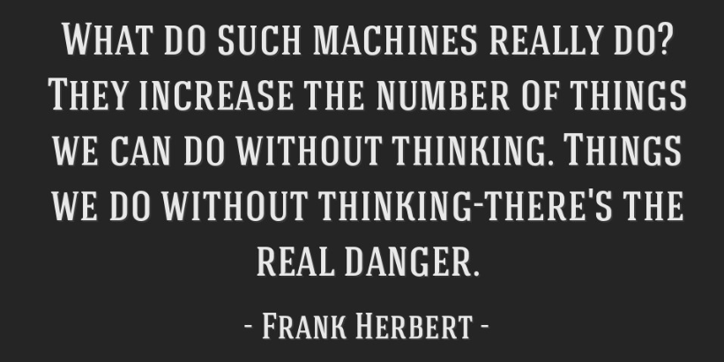
Rules for Chat GPT / Claude/ AI Tools
USE IT FOR:
Finding functions you need
Double checking your work, improving it
Dealing with errors you cannot solve despite trying
DO NOT USE IT FOR:
Errors you have not tried to solve
Having it write the code for you

Slide 17
